Slide 1
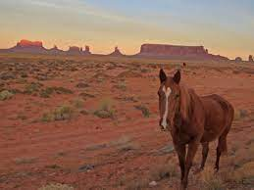
A Tool With No Name
Robert Reitmeier, Validas AG
Notes:
+

Slide 2

Contents
Recap: The Challenge by Example
How it works
Specific Problems (and their Solutions)
An Example Test
Pragmas and Debugging Facilities
Experience in QkitKnorrBremse
Current State and Outlook
Questions/Discussion
Three occasional quizzes to score sweets!

Slide 3
Recap: The Challenge
Recap: The Challenge by Example
How it works
Specific Problems (and their Solutions)
An Example Test
Pragmas and Debugging Facilities
Experience in QkitKnorrBremse
Current State and Outlook
Questions/Discussion

Slide 4
The Challenge
Library Qualification: ISO26262 demands 100% MC/DC Source Code Coverage for ASIL D !
Given: C Source Code of a Function
Needed: All function arguments (=“test vectors”) ⇒ Test Suite’s MC/DC coverage = 100%

Slide 5
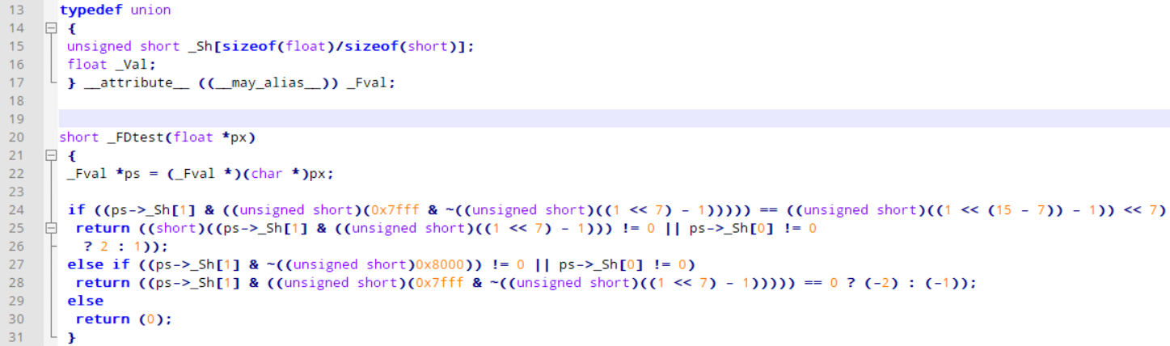
Challenge for You: _FDTest
How many test vectors needed for 100% MC/DC coverage?
if (line 24)
then
else
3
else if (line 27)
T || _
F || F
2
F || T
1
1
2

Slide 6
Challenge _FDtest: Solution
Run _FDtest example

Slide 7
Challenge Result _FDtest
---- Trace [1,1] -----------------------------------
_FDtest ( px = <SOME_PTR> , PTR_px = NaN(0x00ffff) = 0xff80ffff = NaN ) = return_val = 2
Covered branches:
Then branch 1 "if((ps->_Sh[1] & (unsigned short) (0x7fff & ..." at line 24, col 7, len 124
Then branch 1 "(F||T)" at line 25, col 20, len 70

Slide 8
How It Works
Recap: The Challenge by Example
How it works
Specific Problems (and their Solutions)
An Example Test
Pragmas and Debugging Facilities
Experience in QkitKnorrBremse
Current State and Outlook
Questions/Discussion

Slide 9
How Did It Do That?
For all possible paths through the code:
Garble up all decision conditions on each path (if, switch, conditional expressions, loop conditions)
Assume them true or false (depending on the branch to take)
Translate the assumptions to theorem prover language
Have the theorem prover solve the formula
Store solution models (if any)
f(x,y)
if A then
(A(x,y))
else
(¬A)
if B||C then
(B)
if B||C then
(¬B ∧ C)
else
(¬B ∧ ¬C)
return 1;
A ∧ B
return 2;
A ∧ (¬B ∧ C)
return 3;
¬A ∧ (¬B ∧ ¬C)
return 4;
¬A

Slide 10
Definiton of “Trace”
Trace [1,3] (theoretical!)
f(x,y)
True
1
2
if A then
(A(x,y))
else
(¬A)
1
2
3
if B||C then
(B)
if B||C then
(¬B ∧ C)
else
(¬B ∧ ¬C)
return 1;
A ∧ B
return 2;
A ∧ (¬B ∧ C)
return 3;
¬A ∧ (¬B ∧ ¬C)
return 4;
¬A

Slide 11
Z3 Formula for _FDtest [1,1]
if((ps->_Sh[1] & (unsigned short) (0x7fff & ~(unsigned short) ((1 << 7) - 1))) == (unsigned short) ((1 << 15 - 7) - 1) << 7)
; ----------------------------------------------
; COND Then branch 1 "if((ps->_Sh[1] & …
; ----------------------------------------------
(assert
(=
((_ zero_extend 16)
(bvand
(select
arr$$5
#x00000001
)
((_ extract 15 0)
(bvand
#x00007fff
((_ zero_extend 16)
(bvnot
((_ extract 15 0)
(bvsub
(bvshl
#x00000001
#x00000007
)
#x00000001
)
)
)
)
)
)
(bvshl
((_ zero_extend 16)
((_ extract 15 0)
(bvsub
(bvshl
#x00000001
(bvsub
#x0000000f
#x00000007
)
)
#x00000001
)
)
)
#x00000007
)

Slide 12
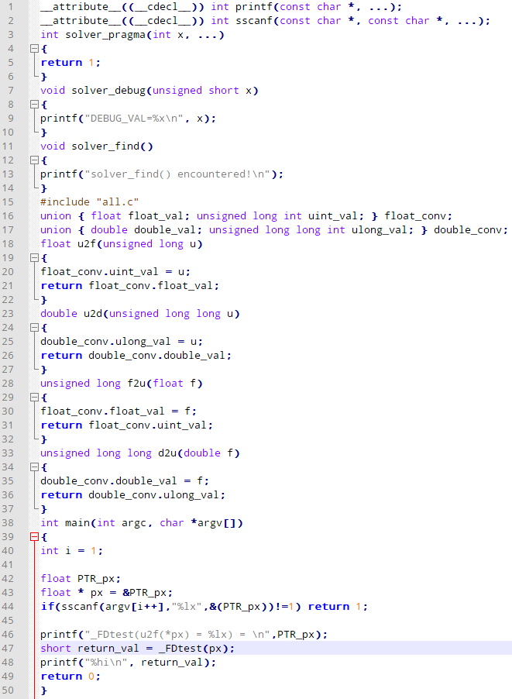
Trace Result Verification
short _FDtest(float *px)
Compile and execute the code: Result = Prediction?
Get arguments from commandline
Execute function Print return value to stdout

Slide 13
Specific Problems
Recap: The Challenge by Example
How it works
Specific Problems (and their Solutions)
An Example Test
Pragmas and Debugging Facilities
Experience in QkitKnorrBremse
Current State and Outlook
Questions/Discussion

Slide 14
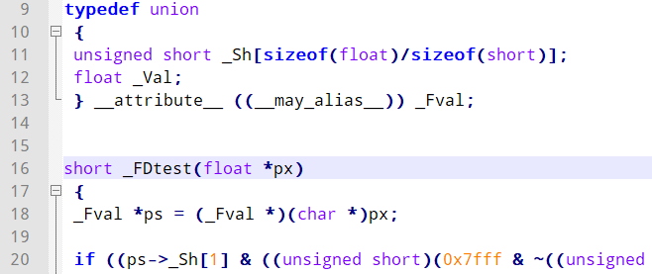
Dirty Detail: Pointer Casting

Slide 15
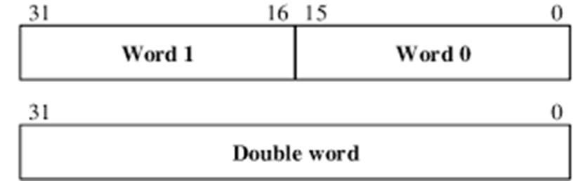
Getting down to Memory Bits
ps->_Sh[0]
ps->_Sh[1]
:: unsigned short
*px
:: float

Slide 16
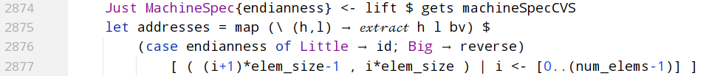
Memory Bits Code

Slide 17
What about the Array?

Slide 18
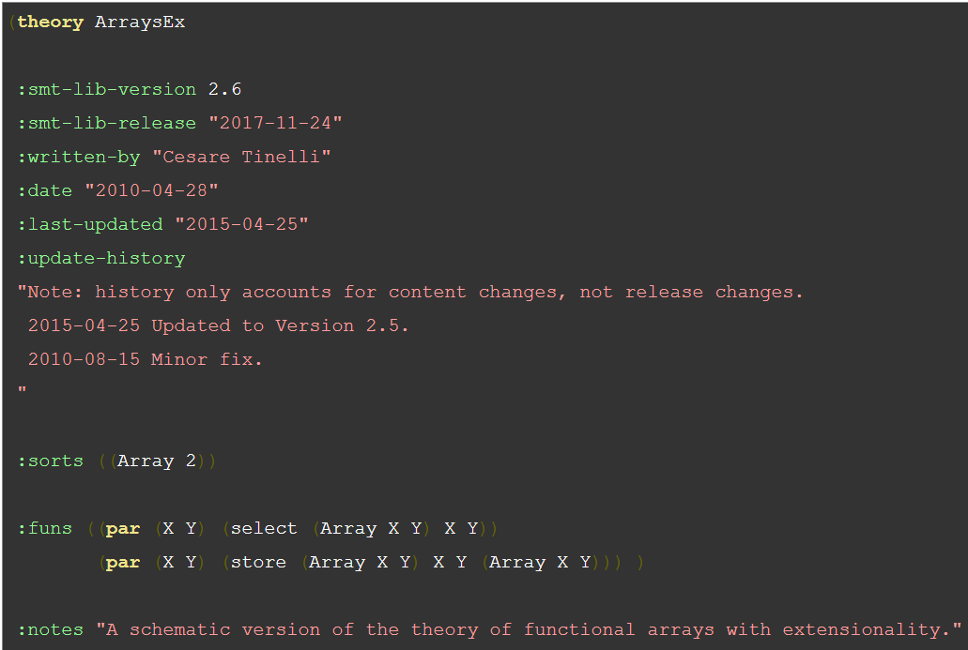
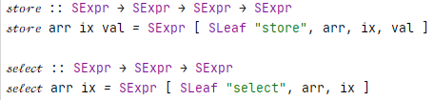
Z3 Array Theory
Old
New

Slide 19
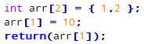
Translation of Arrays
DECL arr :: int[2]
ASSN arr[0] = 1
ASSN arr[1] = 2
ASSN arr[1] = 10
RET arr[1]
Array Re-Assignment
Trans- former
elimArrayAssignsM
DECL arr$$$1 :: int[2]
ASSN arr$$$1 -> arr$$$1[0] = 1
ASSN arr$$$1 -> arr$$$1[1] = 2
DECL arr$$$2 :: int[2]
ASSN arr$$$1 -> arr$$$2[1] = 10
RET arr$$$2[1]
Solver
(= arr$$$1 (𝓈𝓉𝑜𝓇𝑒 0 1 arr$$$1))
(= arr$$$1 (𝓈𝓉𝑜𝓇𝑒 1 2 arr$$$1))
(= arr$$$2 (𝓈𝓉𝑜𝓇𝑒 1 10 arr$$$1))
(= return_val (𝓈𝑒𝓁𝑒𝒸𝓉 1 arr$$$2))

Slide 20
Backwards GOTO
label: …
…
goto label
Label: Store unfoldM function call (as a value!)
GOTO: Retrieve unfoldM function call and continue with it
It works, because:
Function calls are first class values.
Computation Side Effects are encapsulated.
State in unfoldM Monad should not be stored with the label! → Contains only “constants” w.r.t. unfoldM computation
BTW: Example for Theory put into Practice!

Slide 21
MC/DC Table Generation
New ?!
Works inductively. Given MC/DC Tables for A and B: How to combine them to get a table for A || B ?
Example: A || (B1 && B2 )
A | A
F | F
T | T
||
B1 | B2 | B1 && B2
F | _ | F
T | F | F
T | T | T
concat
Sidenote:
Dual for A && B
For A ∧∨ B : a bit more complex (works symmetrical)
A | B1 | B2 | A || (B1 && B2)
F | F | _ | F
F | T | F | F
F | T | T | T
T | _ | _ | T
Don‘t care

Slide 22
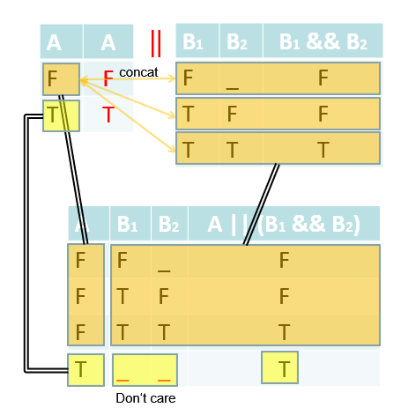
MC/DC Table Implementation
createMCDCTables :: CExpr → [ MCDC_Branch ]
createMCDCTables expr = case expr of
CBinary binop expr1 expr2 _ | binop ∈ [ CLorOp, CLndOp ] →
[ MCDC_Branch ("("++name1++ (render.pretty) binop ++ to_dontcare name2 ++")") shortcut cond1 |
MCDC_Branch name1 result1 cond1 <- t1,
result1 == shortcut,
MCDC_Branch name2 _ _ <- take 1 t2 ]
++
[ MCDC_Branch ("("++name1++ (render.pretty) binop ++name2++")") result2 (cond1 ⋏ cond2) |
MCDC_Branch name1 result1 cond1 <- t1,
result1 == not shortcut,
MCDC_Branch name2 result2 cond2 <- t2 ]
where
shortcut = case binop of
CLorOp -> True
CLndOp -> False
(t1,t2) = ( createMCDCTables expr1 , createMCDCTables expr2 )
to_dontcare s = for s $ \case
'F' -> '_'
'T' -> '_'
other -> other
expr → [ MCDC_Branch "T" True expr,
MCDC_Branch "F" False (not_ expr) ]

Slide 23
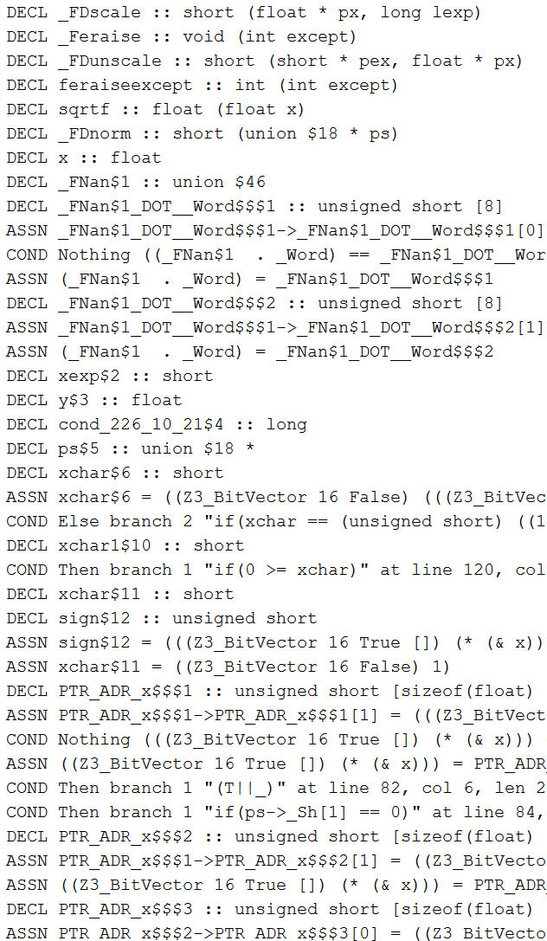


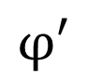

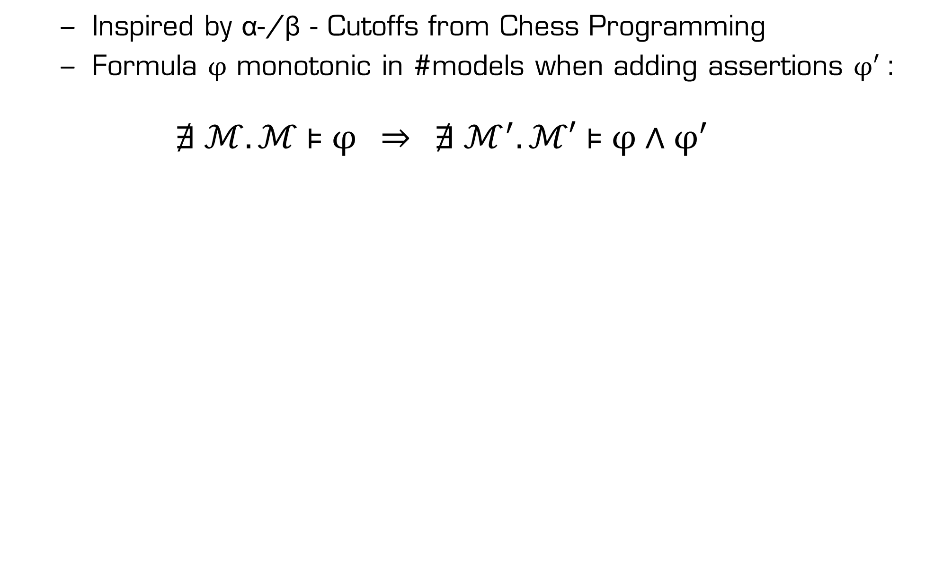
Cutoffs
Inspired by α-/β - Cutoffs from Chess Programming
Formula $φ$ monotonic in #models when adding assertions $φ′$:
$$∄ ℳ. ℳ \text{⊧} φ \overset{⇒}{ } ∄ ℳ^{′}.ℳ′ \text{⊧} φ \text{∧} φ^{′}$$
$$φ$$
Towards RETURN
Cutoff if no solution for $φ !$
$$φ′$$

Slide 24
Efficiency of Laziness in Time
Lazy := Unneeded expressions are not evaluated
Note: Efficient Implementation
comes by design!
Towards RETURN
not evaluated !
Stats { cutoffTriesS = 28851, cutoffsS = 28635, numTracesS = 29037, numSolutionS = 8, numNoSolutionS = 179 }

Slide 25
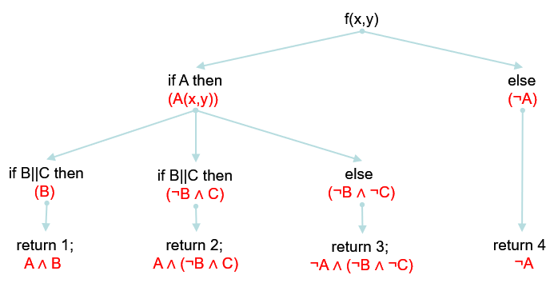
Efficiency of Laziness in Space
Producer Consumer Pattern:
Producer Consumer
Parser
AST
Unfolder
Trace
Trans- former
Conditions
Solver
C
Stimuli
Huuuuge Path Tree

Slide 26
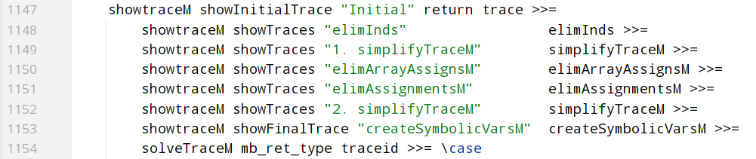
Trace Transformation
Cancel out ptr deref and address-of: *(&x) ⇝ x e.g.
Eliminate casts, some normalization: (*px).mem ⇝ px->mem
Translate array assignments (see before)
Eliminate assignments by backwards forward substitution (sic!)
Simplify again
Create symbolic variables: px->mem ⇝ px_ARROW_mem e.g.
Translate to Z3 and feed into Solver

Slide 27
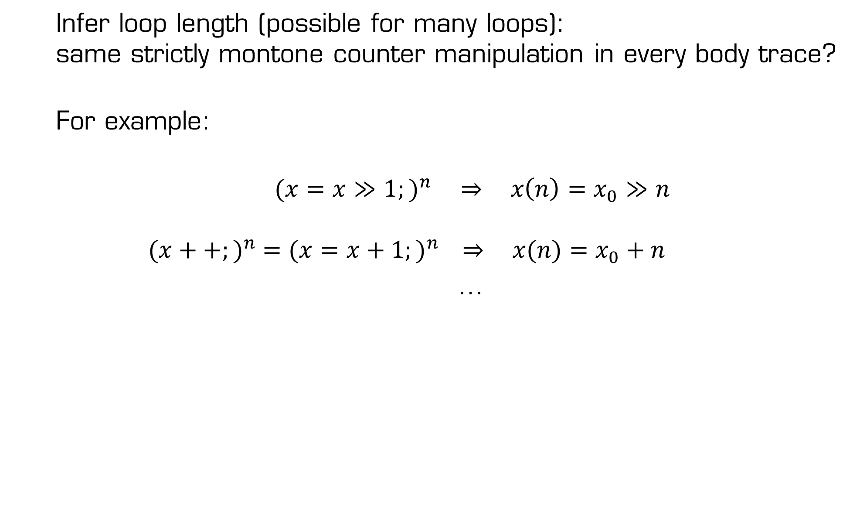
Loop Length Inference
Infer loop length (possible for many loops): same strictly montone counter manipulation in every body trace?
For example:
${(x=x≫1;)}^{n} \underset{⇒}{ } x\left(n\right)=x_{0}≫n$ $${(x++;)}^{n} ={(x=x+1;)}^{n} \underset{⇒}{ } x(n)=x_{0}+n$$
…
n ⩾ _0
not_ cond_0 ⋏ n ⩵ _0 ⋎ cond_nminus1 ⋏ n ⩾ _1 ⋏ not_ cond_n

Slide 28

Loop Length Inference Example
How long is the loop?
Run fp-bit.c : _fpdiv_parts
See log.html for inferred loop length
Show a Trace and Z3 model
Also Example for
solver_pragma
solver_find
bit = IMPLICIT_1; // := 2^30
quotient = 0;
while (bit)
{
if (numerator >= denominator)
{
quotient |= bit;
numerator -= denominator;
}
bit >>= 1;
numerator *= 2;
}
n ⩾ _0
¬cond_0 ⋏ n ⩵ _0 ⋎ cond_nminus1 ⋏ n ⩾ _1 ⋏ ¬cond_n
n ⩾ _0
¬(1<<30 /= 0) ⋏ n ⩵ _0 ⋎ ((1<<30)>>(n-1) /= 0 ) ⋏ n ⩾ _1 ⋏ ¬((1<<30)>>n /= 0)

Slide 29
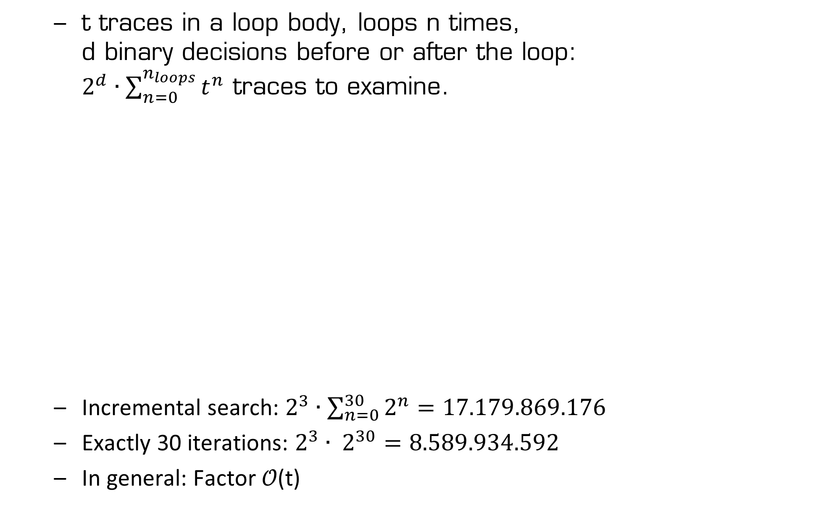
Loop Length Inference Efficiency
t traces in a loop body, loops n times, d binary decisions before or after the loop: $2^{d}∙\sum_{n=0}^{n_{loops}}{t^{n}}$ traces to examine.
Incremental search: $2^{3}∙\sum_{n=0}^{30}{2^{n}}=17.179.869.176$
Exactly 30 iterations: $2^{3}∙ 2^{30}=8.589.934.592$
In general: Factor 𝒪(t)
bit = IMPLICIT_1; // = 1<<30
quotient = 0;
while (bit)
{
if (numerator >= denominator)
{
quotient |= bit;
numerator -= denominator;
}
bit >>= 1;
numerator *= 2;
}

Slide 30
Other Problems
C Type Inference needed
Handling of (nested) Function Calls
Handling of Variable Shadowing (i.e. Renaming)
Handling of Loops
Handling of Structures, Unions, Pointers (Normalization)

Slide 31
Example Test
Recap: The Challenge by Example
How it works
Specific Problems (and their Solutions)
An Example Test
Pragmas and Debugging Facilities
Experience in QkitKnorrBremse
Current State and Outlook
Questions/Discussion

Slide 32
Switch/Case/Break Test
1: int f(int x,int y) {
2: int a = 0;
3: switch(x) {
4: case 1:
5: a = a+1;
6: a = a+0;
7: break;
8: a = a+1;
9: case 2:
10: if(y>0) {
11: a=a+20;
12: switch(y) {
13: case 0 : a=a;
14: case 1 : a=a+100;
15: case 2 : a=a+50;
16: break;
17: default: a=a+1000; } }
18: else {
19: for(int i=0;i<3;i++) {
20: if(i>=2) break;
21: a++; }
22: a++;
23: break; }
24: a = a + 3;
25: case 3: a = a + 4;
26: break; }
27: a++;
28: return a; }
Part of incomplete Test Suite.
Quiz: Find all dead branches!
Run analysis and show results.
Complete Test Suite?!

Slide 33
Pragmas And Debugging
Recap: The Challenge by Example
How it works
Specific Problems (and their Solutions)
An Example Test
Pragmas and Debugging Facilities
Experience in QkitKnorrBremse
Current State and Outlook
Questions/Discussion

Slide 34
Solver Pragma Function
solver_pragma(…) :
→ Only follow one path at a time
1
2
if (solver_pragma(2,3) && A) then
…
1
3
1st
2
2nd
…
…
…

Slide 35
Solver Pragma for Loops
solver_pragma ( i1 , i2 , … ) in loop condition:
→ Unroll loop i1 , i2 , … times only
for(int i=0;solver_pragma(0,1,2) && i<(n%3);i++)
{
if(arr[i]>0) arr[i] *= 2;
j += arr[i];
}

Slide 36
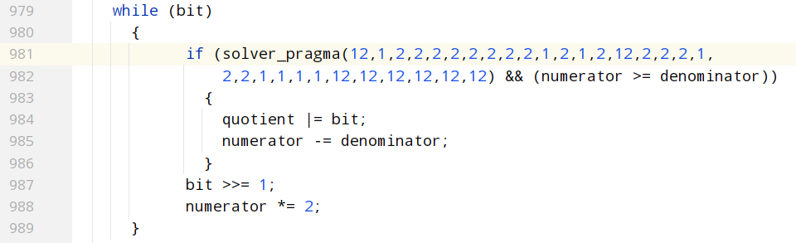
Solver Pragma Usage Example
Can’t infer loop length in _fpdiv_parts
Heuristic: Fix most bits (guess!), just leave some free

Slide 37
Solver Find
short _FDint(float *px, short xexp)
{
_Fval *ps = (_Fval *)(char *)px;
unsigned short frac;
short xchar = (ps->_Sh[1] & ((unsigned short)(0x7fff & ~((unsigned short)((1 << 7) - 1))))) >> 7;
if (xchar == ((unsigned short)((1 << (15 - 7)) - 1)))
return ((ps->_Sh[1] & ((unsigned short)((1 << 7) - 1))) == 0 && ps->_Sh[0] == 0
? 1 : 2);
else if ((ps->_Sh[1] & ~((unsigned short)0x8000)) == 0 && ps->_Sh[0] == 0)
return (0);
xchar = (0x7e + 16 + 7 + 1) - xchar - xexp;
if (xchar <= 0)
return (0);
else if ((16 + 7 + 1) <= xchar)
{
ps->_Sh[1] &= ((unsigned short)0x8000);
ps->_Sh[0] = 0;
solver_find();
return ((-1));
}
else
{
static const unsigned short mask[] = {
0x0000, 0x0001, 0x0003, 0x0007,
0x000f, 0x001f, 0x003f, 0x007f,
0x00ff, 0x01ff, 0x03ff, 0x07ff,
0x0fff, 0x1fff, 0x3fff, 0x7fff};
static const size_t sub[] = {0, 1};
frac = mask[xchar & 0xf];
xchar >>= 4;
frac &= ps->_Sh[sub[xchar]];
ps->_Sh[sub[xchar]] ^= frac;
if (0 < xchar)
frac |= ps->_Sh[0], ps->_Sh[0] = 0;
return (frac != 0 ? (-1) : 0);
}
}
Only consider traces with solver_find ()

Slide 38
Solver Debug
solver_debug(<expr>) :
→ “Model Level Debugging”: Print theoretical value of <expr> at this point
int g(int x,int y) { int erg = x; while(y>0) { solver_debug(y); erg = erg << 1; y=y-1; } if(erg<=1) { erg=100; } return(erg); }

Slide 39
QkitKnorrBremse Experience
Recap: The Challenge by Example
How it works
Specific Problems (and their Solutions)
An Example Test
Pragmas and Debugging Facilities
Experience in QkitKnorrBremse
Current State and Outlook
Questions/Discussion

Slide 40
Project Workflow
… for Code Coverage Completion of a C Function’s Test Suite:
Wait for Ticket Assignment (by Testers)
Extract Source Code Snippets
Manually insert annotations (if necessary or wanted)
Execute Analysis
Copy solutions.txt into Ticket
Add Solutions in ForeSee Test Case Model
Check Coverage Test Run for 100% Coverage

Slide 41
QkitKnorrBremse Experience
ASIL D Library Qualification (Dinkumware and libgcc)
Filling coverage gaps from ForeSEE tests
Found all solutions for
ceilf
__udiv6432
fabsf
roundf
Delivered MC/DC coverage proof for ternary if’s in
_FDtest
Fminf

Slide 42
QkitKnorrBremse sqrtf
sqrtf: 6 traces could not be solved by Z3, Formulae to the power of eight (!)
Show sqrtf source
Search space is vast… 20h on compute server
Show solution.txt
100 % MC/DC coverage of sqrtf, but not all subfunctions fully covered.
We have Ideas on how to solve that anyway ☺

Slide 43
Tool Limitations
_FDscale:
Subfunction of sqrtf
Had to work around expression side effects
Runs ~6 min
Show solutions_sqrtf.txt

Slide 44
Current State And Outlook
Recap: The Challenge by Example
How it works
Specific Problems (and their Solutions)
An Example Test
Pragmas and Debugging Facilities
Experience in QkitKnorrBremse
Current State and Outlook
Questions/Discussion

Slide 45
Strategic Design Principles
Make it as easy as possible for the theorem prover (for example: no ∀, ∃), because:
Z3 not under my control („black box“)
More semantic information available for the tool
Extensive Logging (HTML+JS+CSS)
Defensive Programming: Throw errors in all cases that were not explicitly implemented
Clean Sterile and Abstract Coding:
Single Point Implementation
Strong Type System dear Friend
Generic Programming

Slide 46
Current State of the Prototype
3000 LoC, all in one file (refactoring!)
Works with all (installed) Compilers
Any architecture (integer sizes and endianess are detected)
Extensive logging
Branch, MC/DC, Path coverage
Subfunction coverage
All C except
Expression side effects
Pointers to pointers
Pointer calculation
Some casts not implemented
…

Slide 47
Potentially…
“Dynamic Analysis”: Discovering Semantic/Dynamic Patterns (Error Detection, Optimization)
Making CTC superfluous (How to make enemies ☺)
Outclassing VectorCAST Static Analysis
Oracle for Compiler Test Suites, especially Optimizations! (“extending” SolidSands’ Supertest) => Compiler Qualification
Give Correctness Proofs for Code

Slide 48
Future Work
Find a Name ☺
Approaches for complex calculations (Brute Force vs. Definition Domain Narrowing vs. …)
Professionalize Test Suite (Qualification?)
Refactor (for Side Effects in Expressions, e.g.)
Incremental Solving (pushing assertions, goes well with cutoffs!)
Logical isolation of functions
Better understanding of inner workings of Z3
Extracting compiling Code Snippets automatically
More clever loop inference? (Lower/upper limits e.g.)
C++ (when C++ Parser is available)
Output format for ForeSee
Theory: Show Completeness and Normalization of Trace Transformation Algorithm

Slide 49
Questions/Discussion Notes
Insert here…

Slide 50
